Slide 1
Human Reproduction
Year 11 Human Biology
ATAR
PowerPoint #18

Slide 2
SCSA Syllabus Reference
the production of offspring is facilitated by the structure and function of the male and female reproductive systems in producing and delivering gametes for fertilisation and providing for the developing embryo and foetus
human gametes are produced through spermatogenesis and oogenesis, which are specific forms of meiosis, but varying significantly in process and products
both male and female reproductive systems are regulated by hormones, including the regulation of the menstrual and ovarian cycles

Slide 3
Lesson Intention
To describe the structure of the male reproductive system
To consolidate understanding of the male reproductive system
To describe the structure of the female reproductive system
To explore the process of gamete production
To explore the process of ova production
To explore the process of hormone control in the reproductive system
To explore the processes of menstrual and ovarian cycles
To summarise the structure of the reproductive systems and different reproductive hormones and systems

Slide 4
Success Criteria
identify structures located in the male reproductive system
describe the structures that make up the male reproductive system
explain the function of the male reproductive system and its components
identify structures located in the female reproductive system
describe the structures that make up the female reproductive system
explain the function of the female reproductive system and its components
differentiate between gametogenesis, spermatogenesis and oogenesis
describe the process of sperm production

Slide 5
Success Criteria
draw the annotated diagram of Spermatogenesis Figure 11.8 (pg. 281)
describe the process of ova production
draw the annotated diagram of Oogenesis Figure 11.13 (pg. 284)
describe the different types of reproductive hormones and their purposes
explain the events that take place during the ovarian cycle
explain the events that take place during the menstrual cycle
describe the process of puberty and its effects on the development of secondary sexual characteristics

Slide 6
Vocabulary
Zygote: the fertilised egg from which a new individual develops
Testes: the male sex organs that produce sperm and the hormone testosterone
Sperm: male gametes
Scrotum: the pouch outside the abdominal cavity in which the testes are located

Slide 7
Vocabulary
Lobule: a compartment within the testis that contains the seminiferous tubules
Seminiferous tubules: a tightly coiled duct, located in the testis, where sperm are produced
Epididymis: a highly folded tubule behind each tubule each testis in which the sperm mature

Slide 8
Vocabulary
Interstitial cells: cells located in the mature testis; they secrete testosterone
Vas deferens: the tube that carries the sperm away from the testis; also called the sperm duct
Urethra: the duct that carries urine from the bladder to the exterior; in males it also carries semen

Slide 9
Vocabulary
Semen: the liquid that nourishes and aids the transport of sperm; also called seminal fluid
Seminal vesicles: a pair of pouch-like organs that secrete a thick fluid which is a major part of semen
Prostate gland: a gland that surrounds the urethra just below the bladder; it secretes a fluid that becomes part of the semen

Slide 10
Vocabulary
Bulbo-urethral glands: one of a pair of small yellow glands that secretes a lubricating fluid into the urethra
Erectile tissue: spongy tissue in the penis that fills with blood to produce an erection
Ovaries: the organs in which the female gametes, the ova (eggs) are produced
Ova: mature egg cells

Slide 11
Vocabulary
Stroma: connective tissue in the ovary
Germ cells: cells in the ovary that are able to develop into ova
Follicle: a small secretory sac or gland
Uterine tube: the tube that carries the eggs from the ovaries to the uterus; also called a fallopian tube or oviduct

Slide 12
Vocabulary
Fimbriae: the finger-like projections of the uterine tube
Endometrium: the soft mucous membrane lining the uterus
Cervix: the neck of the uterus, leading into the vagina
Vagina: the canal leading from the uterus to the exterior of the female body

Slide 13
Vocabulary
Hymen: the fold of tissue that covers the external opening of the vagina
Vulva: female external genitalia
Labia majora and minora: the fleshy folds of skin lining the opening to the vagina and urethra
Clitoris: the erectile organ of the female

Slide 14
Vocabulary
Gametogenesis: the formation and development of the gametes
Spermatogenesis: the formation and development of the spermatozoa
Oogenesis: the formation and development of the ovum within the ovary
Spermatogonia: immature cells lining the seminiferous tubules

Slide 15
Vocabulary
Primary Spermatocytes: diploid cells that undergo the first division of meiosis to produce secondary spermatocytes
Secondary Spermatocytes: haploid cells that undergo the second division of meiosis to produce spermatids
Spermatids: haploid cells produced from spermatogonia by meiosis; they mature to form spermatozoa

Slide 16
Vocabulary
Oogonia: the cells in the ovaries that produce primary oocytes by mitosis
Primary oocytes: diploid cells in the ovary that undergo meiosis to produce haploid secondary oocytes
Primary follicle: a dormant egg within the ovary
Secondary oocyte: haploid cells that undergo meiosis to produce ova

Slide 17
Vocabulary
First polar body: the smaller of two unequal cells formed when the primary oocyte divides during the first division of meiosis
Polar body: a haploid cell produced during oogenesis that contains a nucleus and very little cytoplasm
Second polar body: a polar body formed during the second stage of meiosis

Slide 18
Vocabulary
Endocrine gland: a gland that secretes hormones directly into adjacent tissues.
Hormone: a chemical secreted by an endocrine gland, often carried in the blood; it affects the functioning of a cell or organ
Pituitary gland: an endocrine gland located below the brain

Slide 19
Vocabulary
Gonadotropic hormone: hormones that affect the sex organs
Follicle-stimulating hormone: a hormone that stimulates the development of a follicle in the ovary
Oestrogen: a general name for a female sex hormone; it develops or maintains female reproductive structures

Slide 20
Vocabulary
Luteinising hormone: a hormone that promotes final maturation of the ovarian follicle and formation of the corpus luteum
Progesterone: a female sex hormone produced by the ovaries; it helps prepare the uterine lining for a fertilised egg and the mammary glands for milk secretion
Prolactin: a hormone that promotes milk production during and after pregnancy

Slide 21
Vocabulary
Oxytocin: a hormone produced by the hypothalamus and released by the pituitary gland that has a role in childbirth and lactation
Ovarian cycle: the regular series of events that take place within an ovary of a non-pregnant female, associated with the maturation of an egg
Puberty: the period during which a person becomes sexually mature

Slide 22
Vocabulary
Secondary follicle: a previously dormant (primary) follicle that has begun to develop
Mature follicle: a fluid-filled structure in the ovary; it contains an immature egg and its surrounding tissues
Corpus luteum: the temporary endocrine gland that forms in the ovary after the release of an egg

Slide 23
Vocabulary
Corpus albicans: a fibrous mass of scar tissue left on the ovary after the corpus luteum degenerates
Human chorionic gonadotropin: a hormone produced by the placenta during pregnancy
Menstrual cycle: the regular series of changes that take place in the walls of the uterus of a non-pregnant female

Slide 24
Vocabulary
Menstruation: the periodic discharge of blood and tissue fluid due to the breakdown of the lining of the uterus
Menopause: cessation of menstruation

Slide 25
Zygote
Humans reproduce sexually, joining the male and female sex cells to produce a single cell (zygote) that develops to produce a new individual.

Slide 26
Male Reproductive System
The male gonads consist of 2 testicles (testes), where the male gametes (spermatozoa) are produced.
The testes are supported by the scrotum.
Sperm requires to be cooler than normal body temperature, hence the location of the scrotum and testes outside of the body cavity.

Slide 27
Male Reproductive System
Each testis are divided into between 200 and 300 lobules filled with fine tubes called seminiferous tubules. They are lined with cells that produce sperm.
The tubules join to form a short, straight tubule which eventually joins into ducts. The ducts leave the testis and enter a structure called the epididymis. Between the seminiferous tubules are clusters of interstitial cells that secrete testosterone.

Slide 28
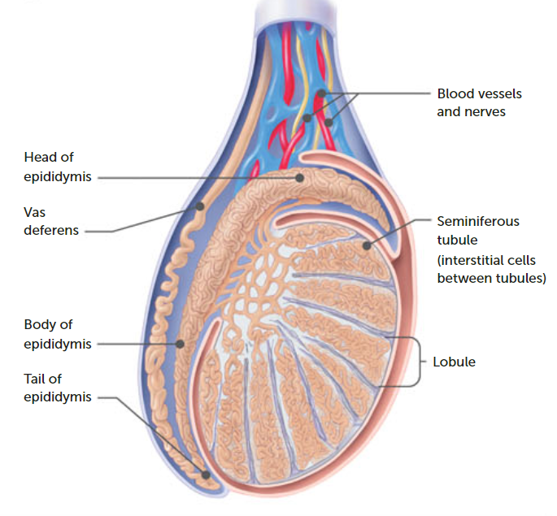

Slide 29
Male Reproductive System
The epididymis is a high folded (SA:VOL) tubule that fits against the rear surface of each testis. The tubules of the epididymis continues to become the vas deferens, which carries the sperm away from the testis.
The vas deferens extends upwards from the testis, looping behind the bladder. Under the bladder, the two vas deferentia (plural form), one from each testis, join the urethra.

Slide 30
Male Reproductive System
For transfer into a female’s body, and to reach the egg for fertilisation, the sperm must be in a liquid. This liquid (semen), nourishes and aids the transport of sperm.
The semen nourishes and aids the transport of sperm. It is a mixture of secretions from three glands- the seminal vesicles, the prostate gland and the bulbo-urethral gland.

Slide 31
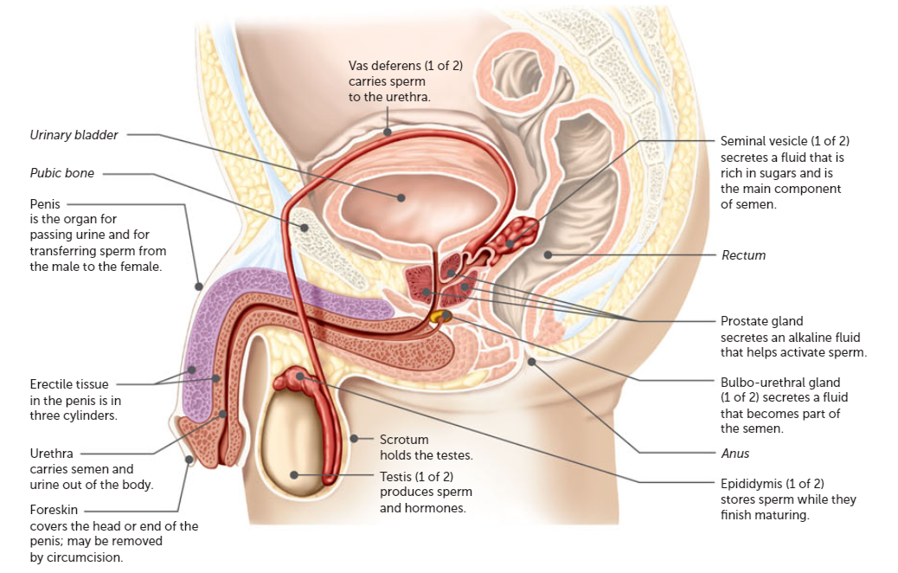

Slide 32
Male Reproductive System
The urethra carries sperm and semen through the penis to a lit-like opening at the tip. In reproduction, the penis is used o transfer sperm to the vagina of the female.
The penis contains connective tissue that has a very rich blood supply. This erectile tissue has a large number of sponge-like spaces, which fill with blood during sexual arousal (erection).

Slide 33
Female Reproductive System
The primary sex organs (gonads) of the female are the two ovaries.
Each ovary is composed of a mass of connective tissue called the stroma. This is surrounded by a layer of cells containing numerous germ cells, each enclosed in a follicle.

Slide 34
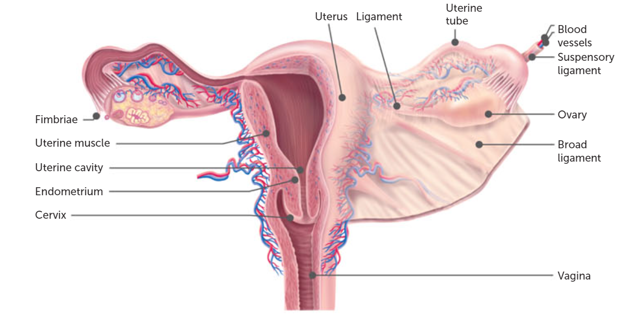

Slide 35
Female Reproductive System
As a follicle matures, it moves to the surface of the ovary and ruptures, expelling an egg into the uterine tube.
Projections called fimbriae help to guide the egg into the uterine tube. Contraction of smooth muscles in the wall of the uterine tube also aids the movement of the egg.

Slide 36
Female Reproductive System
The uterus is a hollow organ situated behind the urinary bladder and in front of the rectum.
At the lower end of the uterus is the cervix, which protrudes into the vagina. The external opening of the vagina is partially covered by a fold of tissue called the hymen.

Slide 37
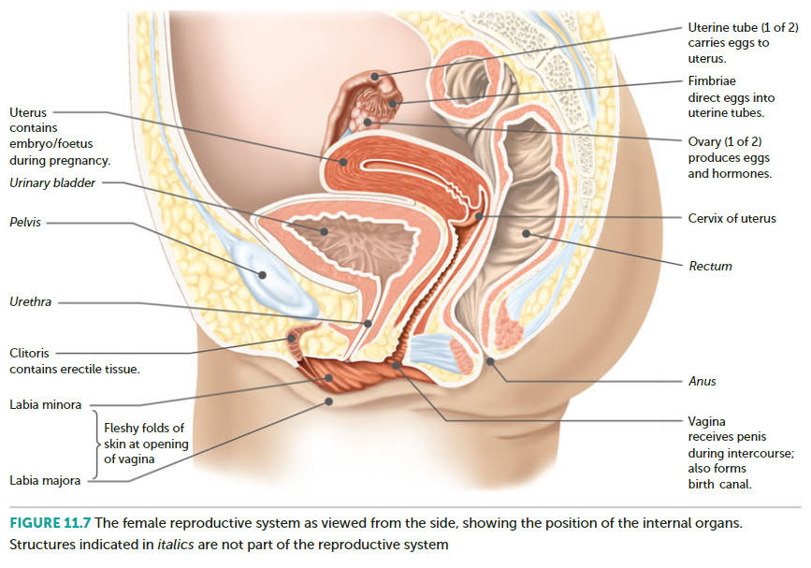

Slide 38
Female Reproductive System
The vagina opens to the exterior in a region termed the vulva, which is made up of three external genital organs:
Labia majora: two fleshy folds of skin, containing a large number of glands that produce oily secretions.
Labia minora: two smaller folds of skin that surround the space into which the urethra and vagina open
Clitoris: contains erectile tissue, blood vessels and nerves. It is very sensitive to touch.

Slide 39
Gamete Production
Gamete development, from meiosis to mature gametes is called gametogenesis. There are two types (spermatogenesis and oogenesis).

Slide 40
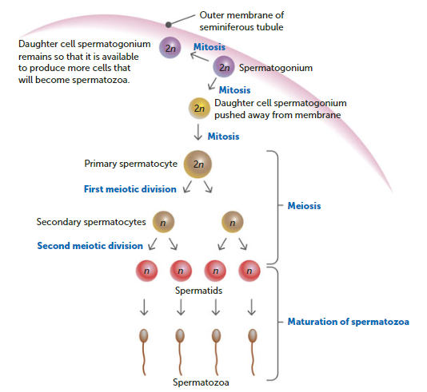
Spermatogenesis
Occurs inside the seminiferous tubules of each testis.
At puberty, the spermatogonia begin dividing via mitosis, providing a continuous source of new cells for the production of new sperm.

Slide 41
Spermatocytes
Some of these daughter cells from the spermatogonia are pushed inward, where they undergo a period of growth. These enlarged cells are called primary spermatocytes.
They are diploid and undergo the first stage of meiosis to produce secondary spermatocytes. These cells are haploid. The second stage of meiosis divides each secondary spermatocyte into two spermatids.
The final stage of spermatogenesis is when the spermatids mature into spermatozoa.

Slide 42
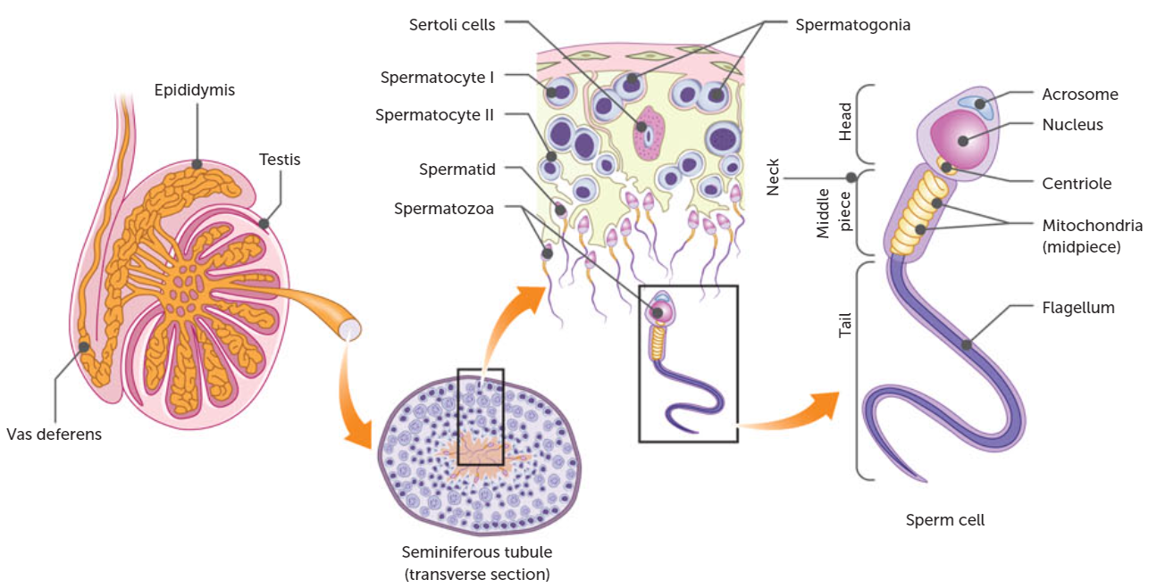

Slide 43
Production of ova
The production of ova within the ovaries is called oogenesis.
Before birth, millions of egg mother cells (Oogonia) develop in the ovaries. These cells are diploid and divide by mitosis to produce the cells that will eventually develop into ova.
At birth, each ovary contains several thousand Oogonia, which have undergone a growth phase to become primary oocytes.

Slide 44
Oocytes
The primary oocytes begin prophase of the first meiotic division and is surrounded by a single layer of cells (primary follicle), but then stop until puberty. As a follicle matures, the primary oocyte contained within it completes the stages of the first meiotic division.
The two haploid cells are different sizes. The larger one (secondary oocyte) receives half the number of chromosomes, but nearly all the cytoplasm. The smaller one (first polar body) receives the other half of the chromosomes but very little cytoplasm.

Slide 45
Secondary Oocyte
It immediately commences the second division of meiosis but stops at metaphase. At this stage ovulation occurs; the follicle ruptures, expelling the secondary oocyte along with its polar body.
The secondary oocyte enters the uterine tube and, if penetrated by a sperm, meiosis is quickly completed. This second meiotic division also produces two haploid cells of unequal size. The large one becomes a mature egg and the smaller one becomes the second polar body.
All polar bodies disintegrate. So in females, oogenesis produces a single ovum from each primary oocyte.

Slide 46
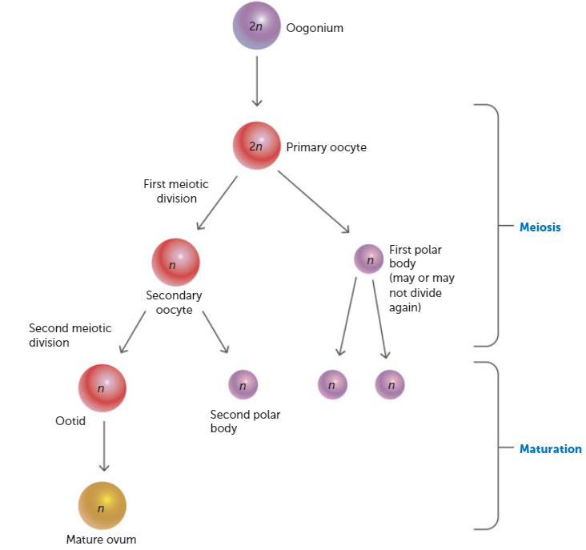

Slide 47
Hormones
The menstrual and ovarian cycles, and other features of the human reproductive system, depend on the endocrine glands for their regulation and control.
These glands release secretions called hormones into the extracellular fluid that surrounds the cells. The secretion then passes into the capillaries for transport to the target organ.
The main target organs involved in reproductive processes are the testes and ovaries.

Slide 48
Reproductive Hormones
The pituitary gland is a small organ located at the base of the brain.
Two hormones secreted by the pituitary affect the gonads and are thus called gonadotropic hormones.
They are the …

Slide 49
Follicle-stimulating hormone (FSH) which stimulates the development and maturation of the ovarian follicle in females. During its development, the ovarian follicle secretes oestrogen. Secretion of FSH is reduced as the level of oestrogen increases in the blood.
Luteinising hormone (LH) promotes the final maturation of the ovarian follicle, ovulation, and the formation of the corpus luteum. The corpus luteum secretes another ovarian hormone, progesterone, as well as oestrogen. There is a gradual reduction in the production of LH as the level of progesterone in the blood increases.

Slide 50
More hormones
The pituitary gland also releases prolactin and oxytocin.
Prolactin has a direct effect on the breasts of women, and is involved in the preparation and maintenance of milk production.
Oxytocin causes uterine contains, promotes the movement of breast milk in the breast, and has a role of sperm and the production of testosterone in the testes.

Slide 51
Pituitary Gland
Follicle Stimulating Hormone
Luteinising Hormone
Seminiferous Tubules
Spermatogenesis
Interstitial cells of testes
Testosterone
Development of immature sperm cells
Maintenance of male reproductive organs
Sex drive

Slide 52
The Ovarian Cycle
Includes the maturation of an egg and its release into a uterine tube. The length of the ovarian cycle is highly variable, depending on the individual and other circumstances.
Only 30% of women fall into the ‘average’ of 28 days per cycle.
When a female matures sexually at puberty, some of the primary follicles which contain a primary oocyte undergo further development. During the first half of the ovarian cycle the levels of FSH and LH slowly increase prompting the growth and maturation of follicles over a 10-14 day period.

Slide 53
Step | Event(s) in follicle development
1 | Cells forming the wall of the primary follicle begin to enlarge and divide, creating a layer of cells around the developing oocyte.
2 | Secretions from these cells create a fluid-filled space that gradually forces the oocyte to the edge of the follicle. It is now referred to as a secondary follicle.
3 | As more fluid accumulates within the follicle, it continues to enlarge and gradually moves towards the surface of the ovary.
4 | On reaching the surface, it produces a bulge that looks like a swollen blister on the surface of the ovary. At this stage it is referred to as a mature follicle.

Slide 54
Ovulation
At ovulation, the mature follicle bursts and expels the oocyte. The open end of the uterine tube is like a funnel over the ovary.
Following ovulation, the ruptured follicle collapses and the blood within forms a clot. The clot is gradually absorbed by the remaining follicle cells, which enlarge and change colour to form the corpus luteum.
The corpus luteum secretes oestrogen and progesterone (development of the lining of the uterus)

Slide 55
Ovulation continued.
If fertilisation has not occurred, the corpus luteum reaches its maximum development about 8 to 10 days after ovulation. It then begins to degenerate into a fibrous mass of scar tissue, the corpus albicans, which eventually disappears.
The corpus luteum continues to develop and the ovarian cycles cease. The corpus luteum is maintained by human chorionic gonadotropin, a hormone produced by the developing placenta in a pregnant woman.

Slide 56
Ovulation continued.
Once the placenta is able to secrete oestrogen and progesterone by itself, the corpus luteum begins to degenerate.

Slide 57
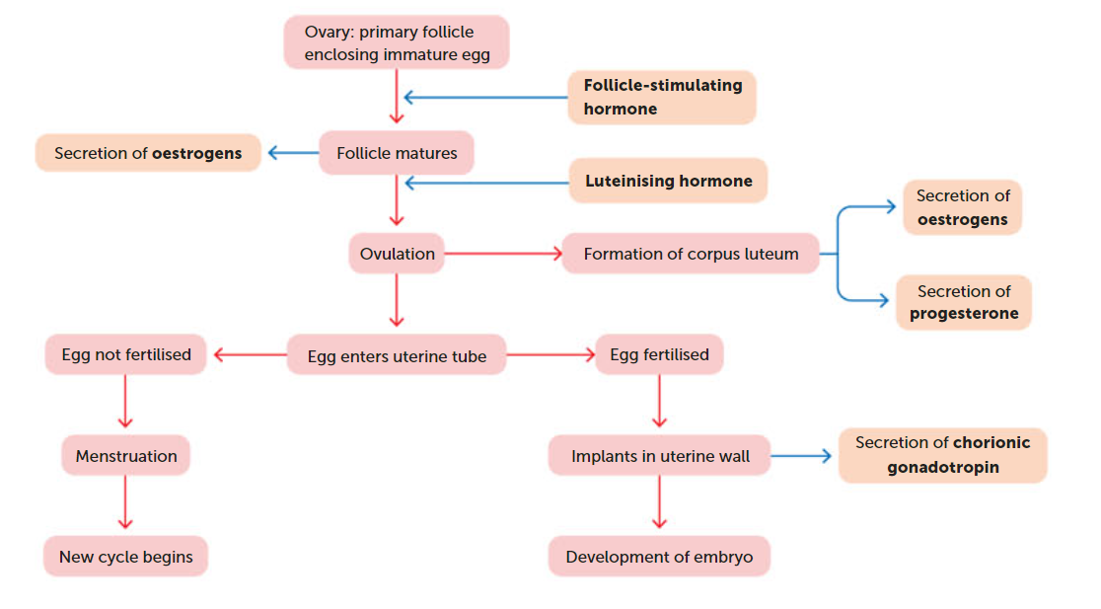

Slide 58
The Menstrual Cycle
While the ovarian cycle is occurring, the uterus and, to a lesser extent, the vagina also go through a series of changes called the menstrual cycle.
A female’s first menstruation is called menarche and marks the commencement of puberty. From that time on, she will have a menstrual cycle about once a month (minus pregnancy) until she hits menopause (about 45-55)

Slide 59
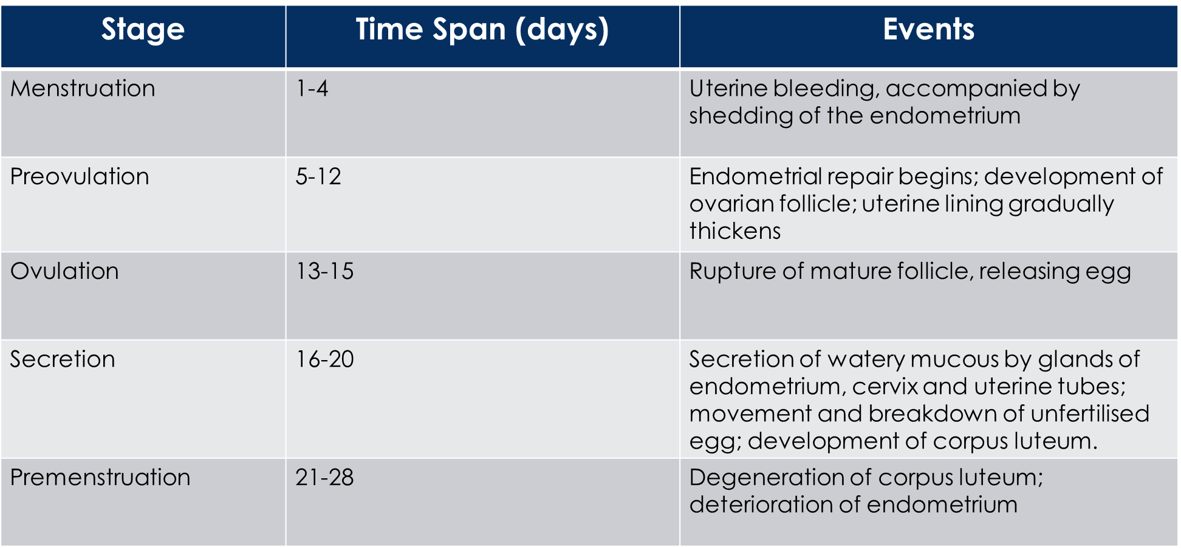

Slide 60
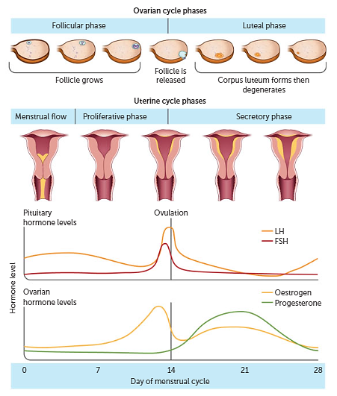

Slide 61
Puberty and the development of secondary sexual characteristics
The secretion of sex hormones at puberty brings about the development of secondary sexual characteristics- those characteristics associated with a person’s sex but not directly involved in reproduction e.g. breasts, broadening of hips, body hair, deposition of fat, lengthening of vocal cords (males).

Slide 62
Hormone | Target Organ | Effect of Hormone
Follicle-stimulating hormone (FSH) from pituitary gland | Seminiferous tubules of testes | Production of sperm
 | Follicles of ovaries | Maturation of ovarian follicles
Human chorionic gonadotropin (HCG) from placenta | Corpus luteum | Maintenance of corpus luteum during early stages of pregnancy
Lactogenic hormone (prolactin) from pituitary gland | Breasts | Production of milk in activated glands
Luteinising hormone (LH) from pituitary gland | Interstitial cells of testes | Stimulates secretion of testosterone
 | Cells of the ovaries | Stimulates secretion of oestrogen and progesterone
Oestrogens from ovarian follicle and corpus luteum | Various | Development of female reproductive system and secondary sexual characteristics
Oxytocin from pituitary gland | Uterus | Stimulates contraction of smooth muscle
 | Breasts | Promotes contraction of muscle around breasts
Progesterone from corpus luteum | Uterus | Maintenance of endometrium
 | Placenta | Development and maintenance of placenta
 | Breasts | Development of milk-secreting glands
Testosterone from cells in testis | Various | Development of male reproductive system and secondary sexual characteristics

Slide 63
Recall Knowledge
List the two types of gametogenesis, and state where they occur.
How are hormones transported around the body?

Slide 64
Apply Knowledge
Name the structures formed, in order, during spermatogenesis
Explain the difference between a primary and secondary follicle
Describe the internal structure of a testis, including the location of sperm production.

Slide 65
Homework
Find out:
The symptoms of endometriosis
Possible causes of endometriosis
How diagnosis is made
The treatment available

Slide 66
Reading
Pages 275- 290: The structure of the reproductive system allows reproduction

